Slide 1
Variables
Notes:
Purpose:
To introduce the use of variables.
Learning objective:
By the end of this tutorial, children should be able to:
Understand that variables can be used to store and manipulate values.
Write simple programs that use variables to count things.
Write simple programs that use values stored in variables to alter their behaviour

Slide 2
Variable
Notes:
Introduce students to key vocabulary for this lesson:
Variable: A variable is a simple way of storing one piece of information somewhere in the computer’s memory whilst a program is running, and of getting that information back later.

Slide 3
A variable stores a piece of information in a computer’s memory while a program is running, that can be retrieved when needed.
Notes:
Explain the concept of a variable.
A variable stores a piece of information in a computer’s memory while a program is running, that can be retrieved when needed.
A variable is an example of a data structure. As pupils move on to secondary school, they will learn about other data structures such as arrays.
A variable can be a number or text or perhaps true/false.
Programs can store, retrieve or change the values of variables. Variables are an abstraction of data storage and retrieval: as programmers, we need not know how exactly the programming language, operating system and hardware manage and handle them.

Slide 4
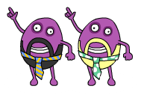
Notes:
Introduce Code Disco:
Children should be encouraged to try running their programs to see what happens. They should not always expect to get it right first time. Testing a program, seeing what goes wrong and then fixing the problem (debugging) is a very important part of coding. Tutorials and challenges in Code Disco always build on what has been learned previously. Children should be encouraged to think about what they've just learned, and see how it can be adapted and extended to solve other problems. Breaking a problem down into simpler problems and then combining the solutions is a very useful strategy in coding.

Slide 5
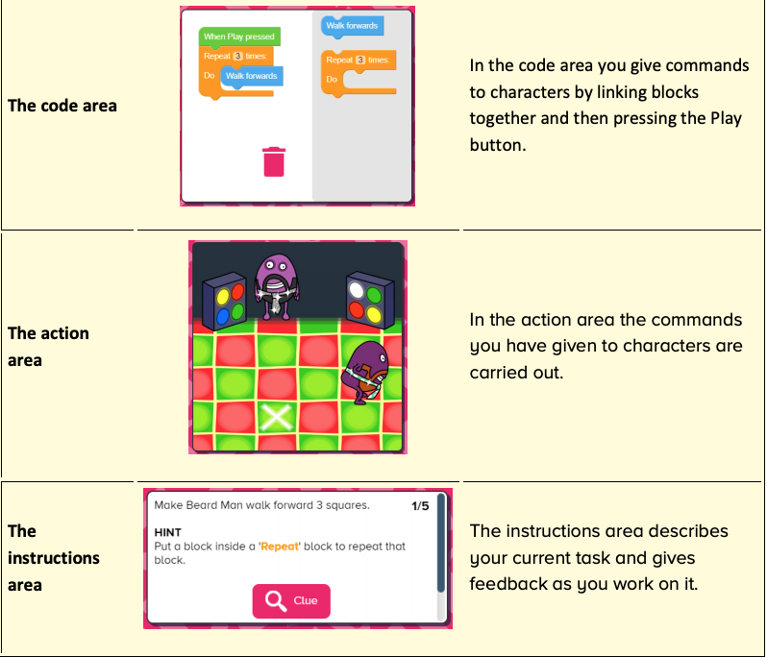
Notes:
Introduce students to Busy Code:
Code area
Action area
Instruction area

Slide 6
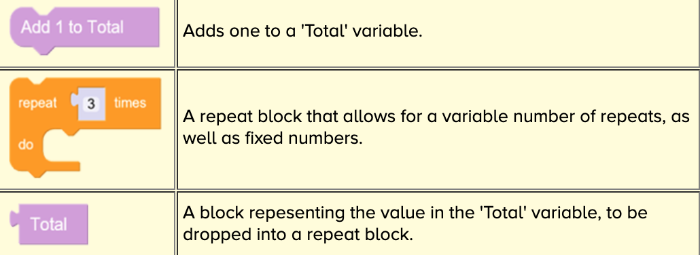
Notes:
Show students the new blocks that will be introduced to them.

Slide 7
Notes:
Tutorials consist of multiple steps that can be worked through.
The objective will be presented in the instructions area in the bottom left of the screen, along with any hints that may help children to complete the stage. Some steps include a clue button which will give a visual clue, normally where a new block type is introduced or an existing block type is used in a new way.
Once each stage is complete, a next button will appear allowing children to move onto the next stage.
Once the final stage has been completed, children can either try any related challenges or projects or can move onto the next tutorial.
You may want to demo this with your students when going through the first instructions together.

Slide 8
Notes:
Challenge resources work in a similar manner to the tutorial resources, but the problems are harder to solve. They are intended to test that children have grasped the concepts introduced in the preceding tutorials.
Each task in a challenge has a suggested block limit the children should try to stay within.

Slide 9
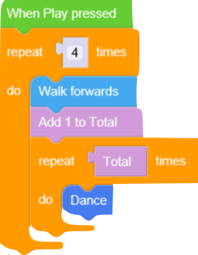
Notes:
Challenges may have many different correct solutions. Below is an example of a correct solution that keeps within the block limit.

Slide 10
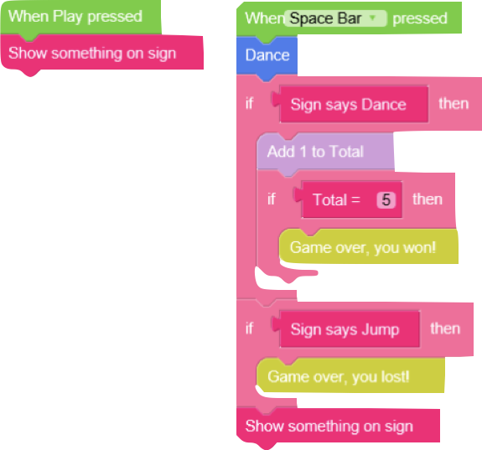
Notes:
Trace though this code, help student read though this block what do they think will happen?
They will be using some of this code in the project they are going to make.

Slide 11
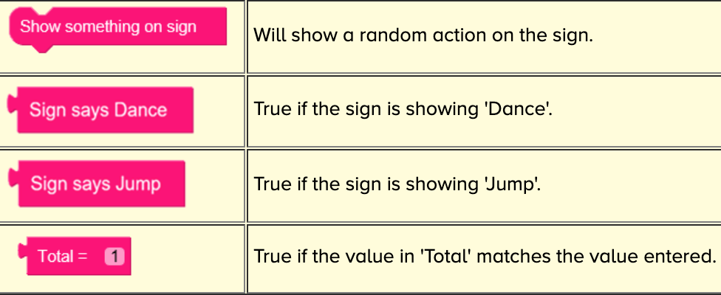
Notes:
Show students the new blocks that will be introduced to them.

Slide 12
Notes:
Project resources are open-ended tasks that give children the chance to be creative with what they have learned so far.
Each project is concentrated on a specific theme and only provides the relevant blocks/characters/props to work within that theme.
There are no correct answers and children should be encouraged to experiment. Projects are often provided in multiple versions, so children can revisit a similar idea once they have learned more and elaborate on their previous ideas. Projects can be saved.
Objective
Create a simple 'Call and response' game. The sign should flash up random instructions. The player should press the appropriate key to perform the requested action. The game should respond to the player letting them know if they got it right or wrong. The game can be extended to add scoring, using the 'Total' variable.
Allow time at the end of the session to share their dances with each other, to do this remind student they need to have named and save their project.

